Slide 1
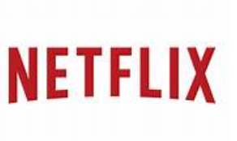

Planning / Design:
Fail clearly state the goal of the case - is to help Netflix users find the content that they are interested in before losing interest.
Risk is customer not interested and abandon service .
Challenge is to provide fast and accurate recommendation for customer retention.
Highlight of the case study is to analyse other deep learning models used by Facebook, Google and youtube etc., to address the limitations of existing modes
Validate existing traditional methods against other deep learning models .

Slide 2
Data Collection :
Case lacks in addressing how each model differ in terms of their performance .
What limitations are there with the current modelling techniques .
What is the need to research into use of Deep learning models.
Matrix-factorization models such as SVD++ , Restricted Boltzmann Machines RBM(s) what are the limitations ?

Slide 3


Axion fact store : ML models used by Netflix and its limitations :
Netflix uses data online and offline : Ex viewing history of the members.
Online Data
Offline Data

Slide 4
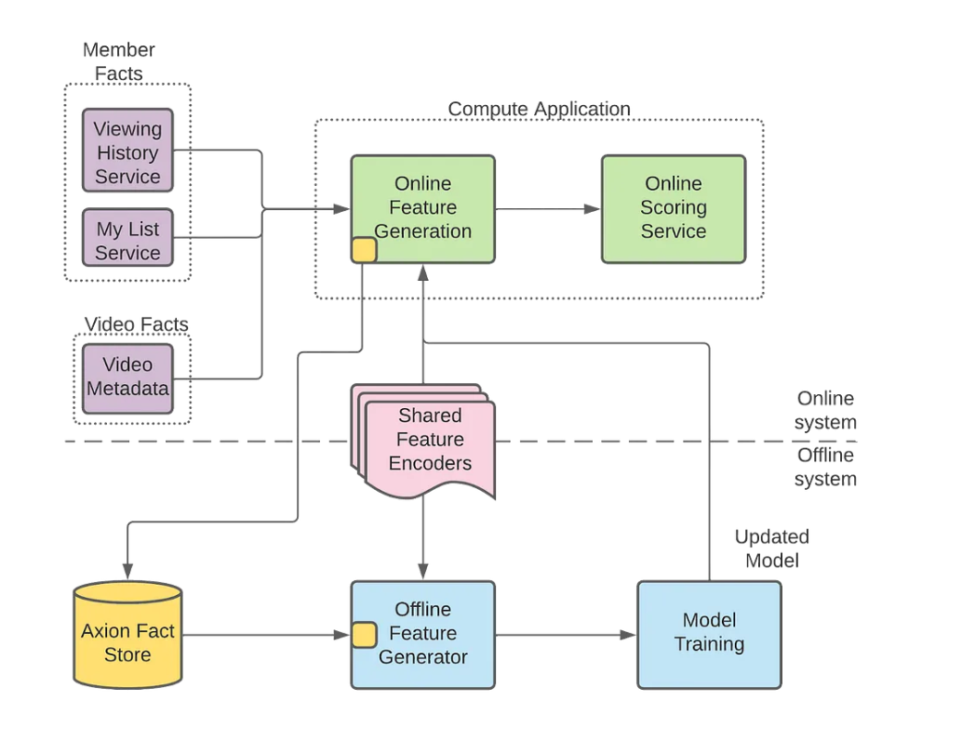
Use of Axion Fact store in collecting offline and online content
Both online and Offline data used to train the Modles
Models can get as much better as they train . More features data better the model performance

Slide 5
Facts of SVD++ Mechine Learning Model.
SVD++ Recommendation Algorithm Based on Backtracking
It is the enhancement of SVD (Singular Value Decomposition)
Limitation of SVD++ is slower computation power. Process should be iterated too many times to attain accuracy .

Slide 6
To address limititions of Bag of items approach , research into Sequential model approach
It is useful to catch sequential nature of user play history which gets removed in bag of items approach
If is important for modles to know if a user has abandoned the content after 1 episode or watched the entire episord with in certain time frame
Modles fails to show same level of accuracy when trained in offine mode and test with online data .
Online data is not the same as offline data

